Slide 1
Welcome to new York mini 2018

Slide 2
Announcement: Tents at Seward Park volleyball and basketball courts are NOT ALLOWED. Any team that fails to do so will be asked to take down their tent. A penalty will occur from your team’s security deposit.

Slide 3
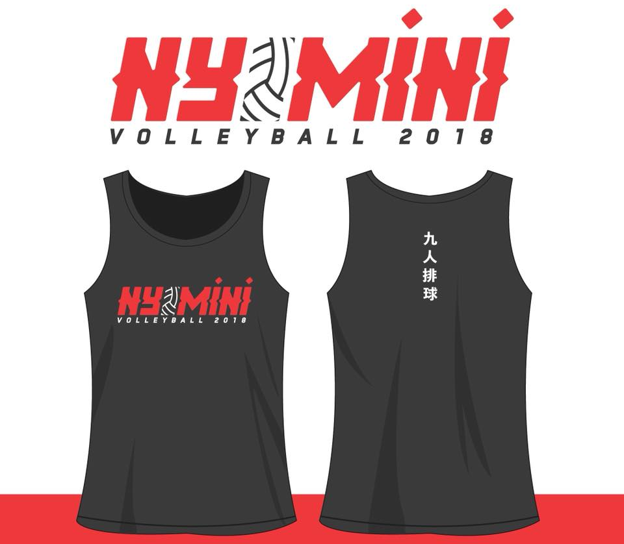
Pre-ordered tournament fundraiser tanks are available at the main command center in Seward Park Tennis Courts from _______________.
Come pick up

Slide 4
We are happy to announce that we will be partnering with Bruce Cost Ginger Ale this weekend to bring you a NEW FLAVOR! Come by and visit their tent located next to the main command center at Seward Park Tennis Courts.
Bring your phones! We want to know what you think – post your thoughts on Instagram and tag #NYMini and #BruceCostGingerAle!

Slide 5

We are happy to announce that New York Chiropractic College will be here for the whole weekend (9am - 5pm, Sat & Sun)! Feeling sore after your match? Come by and visit their tent located next to the main command center at Seward Park Tennis Courts.

Slide 6

Thank you to our sponsor: David J. Louie, Inc.
David J. Louie, Inc. is a general agency serving producers as well as personal and commercial insurance customers. We are proud to be one of the largest Asian-owned independent insurance agencies in New York. David J. Louie, Inc. was founded in 1976 with the goal of providing individuals and businesses in the Asian community with expert insurance counseling and prompt, respectful service. In 1992, DJL extended its services to smaller insurance producers who come to us for assistance in fulfilling their clients’ needs.
Visit http://davidjlouie.com/ for more information!

Slide 7
Thank you to our sponsor: Chinatown Partnership
Chinatown Partnership, led by Wellington Chen, was formed in 2006 as a new start-up from grounds up to bring residents, business owners, and community groups together to rebuild Chinatown following 9/11, and to preserve the neighborhood's unique culture while ensuring its vitality in the future through strategic positioning. With the highly popular Weekend Walks street festive series, Mid-Autumn Festival, One Day in NYC, annual Beautification/Earth Day, East-West Parade with Little Italy, Double Valentine’s Day to promote the softer side of Chinatown and the Jewelry District and all the cafes, eateries in the area. Explore Chinatown marketing initiative, Lunar Stages outdoor film screenings, and Taste of Chinatown street events, Chinatown Partnership helps promote the area as a special destination to live, work, and visit.
Visit http://www.chinatownpartnership.org/ for more information!

Slide 8
Thank you to our sponsor: American Legion Lt. B. R. Kimlau Chinese Memorial Post 1291
American Legion Lt. B. R. Kimlau Chinese Memorial Post 1291 is also another long supporter of our annual volleyball tournament. We thank you for your support and services!
Visit http://www.ltkimlau.com/ for more information!

